Slide 1
Conflict Early Warning and Crisis Mapping in Nigeria
December 2013

Slide 2
Why Doesn’t EW Work?
Warning the wrong people about things they already know.
Notes:
Rare: High probability of conflict onset. EWS raises red flag. Political will is mobilized to respond.
Common: High probability of escalation/continuation/expansion/mutation. EWS points out the obvious. Everyone does what they were going to do anyway.

Slide 3

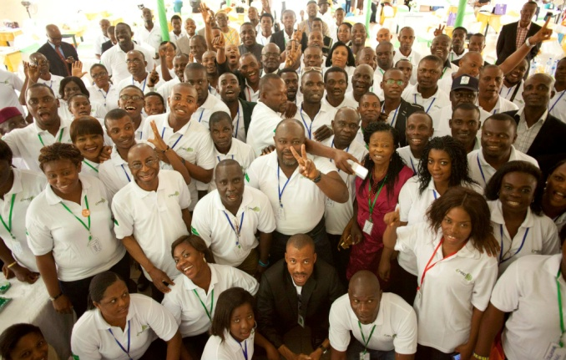
Change the Paradigm
From
To
Notes:
From Red flags/political will to multistakeholder information sharing and collaboration for improved conflict management

Slide 4

The Challenge
Finger-in-the-Wind Syndrome
Site Selection
Project Design
Baseline Assessments
Monitoring and Evaluation

Slide 5
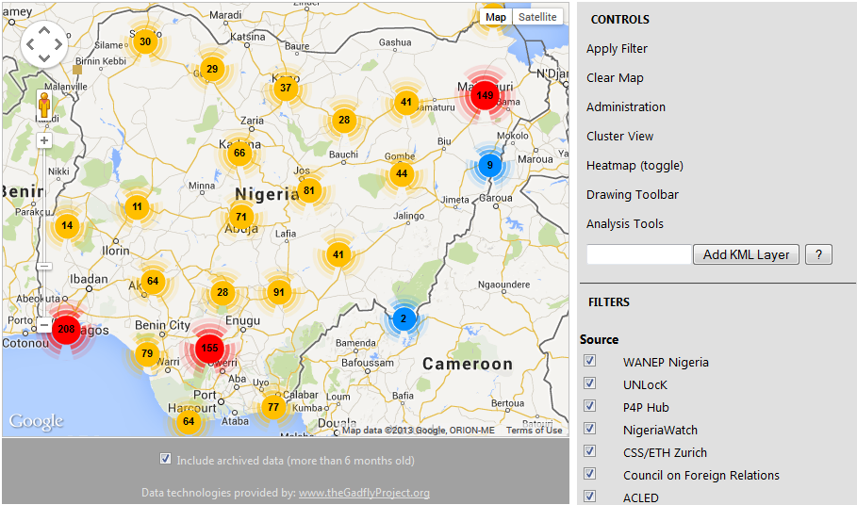
Share Knowledge

Slide 6
Why Multi-Stakeholder?
Information Sharing and Collaboration
  Because different stakeholders know different things
  Because everyone must be involved for peacebuilding to be successful
  Ownership and Buy-In by primary stakeholders and beneficiaries
  Promote Social Capital for Peacebuilding

Slide 7
Multi-Stakeholder Initiative
Academia
Policy Community
Civil Society
Private Sector
Community Based Organizations
Donor Community

Slide 8
Holistic Framework
A Human Security Lens (Peaceable Livelihoods)
  For Wide Relevance to Diverse Stakeholders
  Because solving militancy or terrorism alone is not enough for sustainable security
  Because peace enables economic development which enables peace (Virtuous Cycle).

Slide 9
Virtuous Cycle (Not Binomial)
Security
Development
Safety
Investment
GDP
Growth

Slide 10
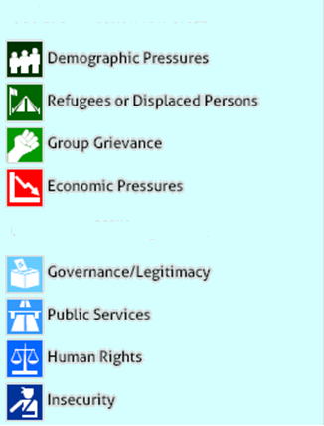
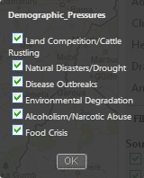
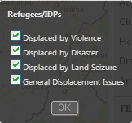
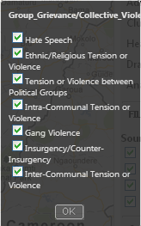
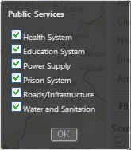
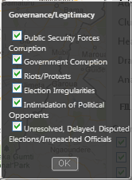
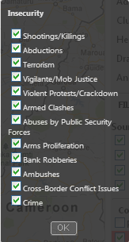
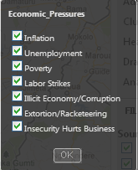
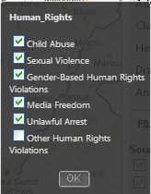
The Framework

Slide 11
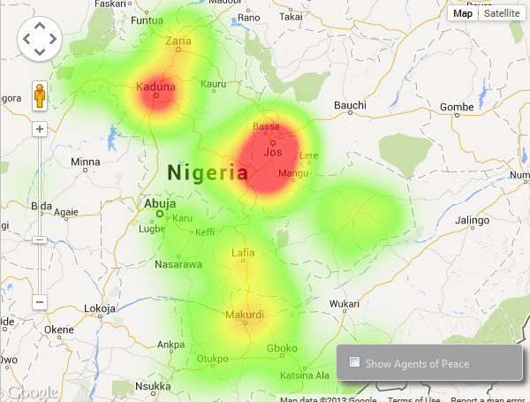
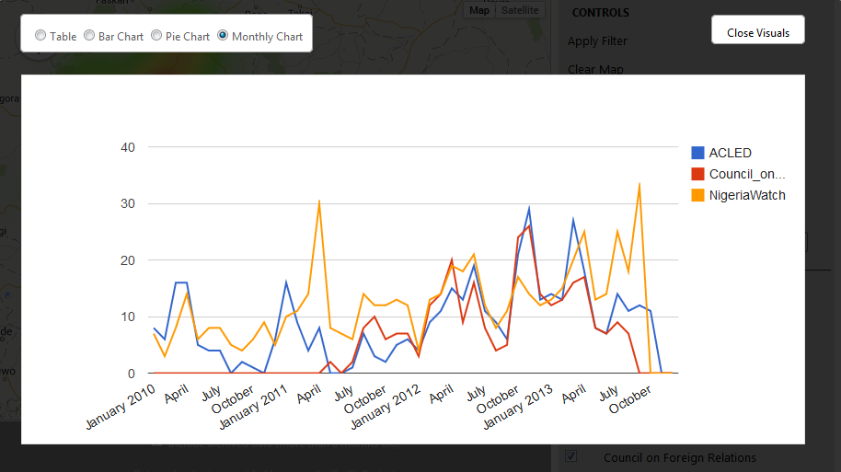
What We Need to Know: Hot Spots/Trends
Reported incidents resulting in fatalities in the Middle Belt States

Slide 12
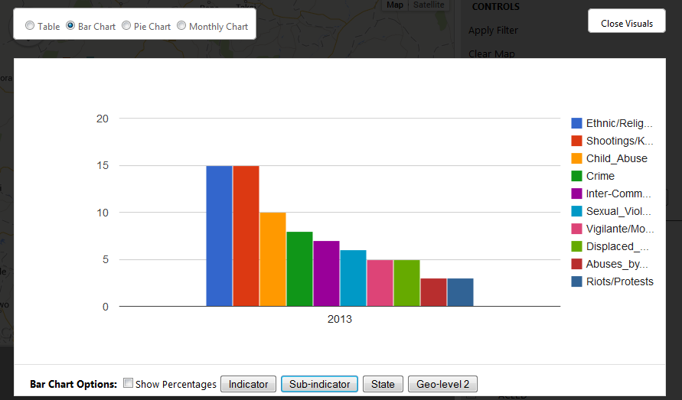
What We Need to Know: The Issues
Sub-Indicators in Kaduna/Benue/Plateau/Nasarawa States (UNLocK/WANEP data formatted to P4P Web Map)

Slide 13
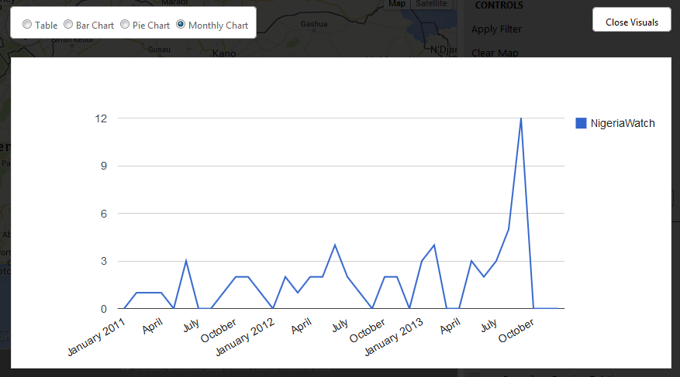
Nasarawa Escalation
Not Pastoralist
Not Over Indigeneity
Not Christian/Muslim
Not Boko Haram

Slide 14
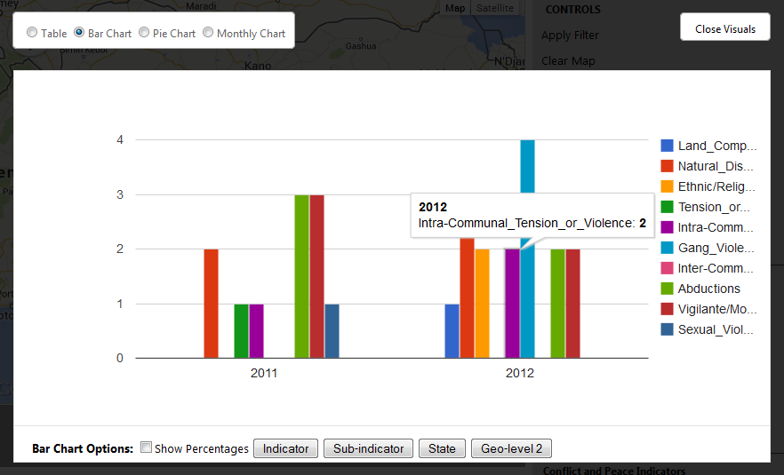
What We Need to Know: The Issues
Sub-Indicators in Delta State (UNLocK/WANEP data formatted to P4P Web Map)

Slide 15
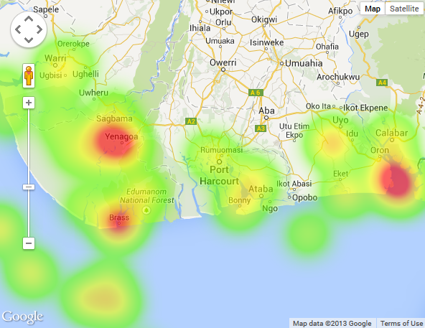
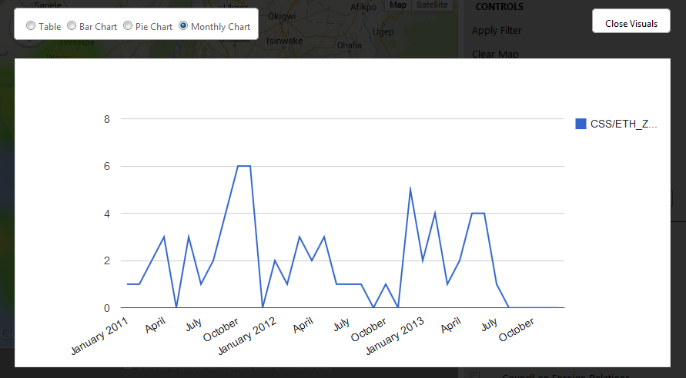
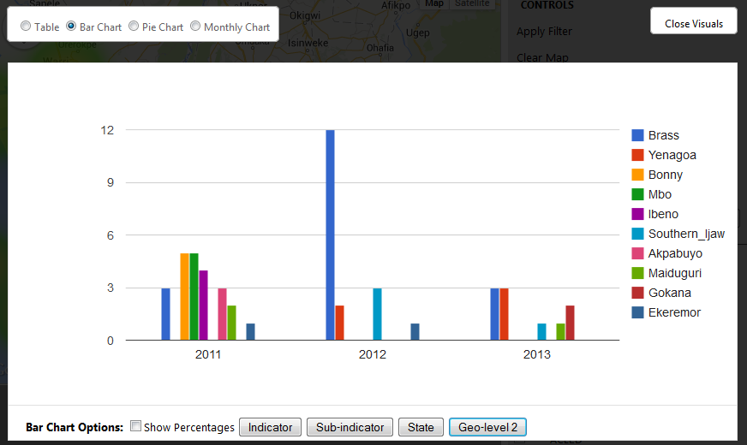
Attacks on Energy Infrastructure
CSS/ETH Zurich Data

Slide 16
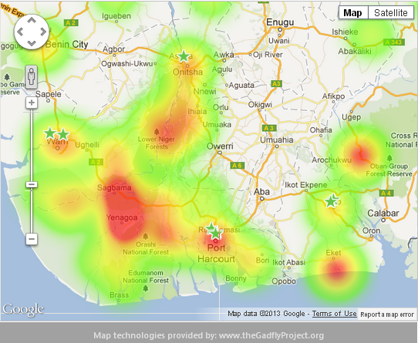
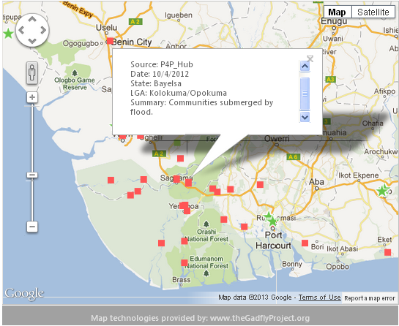
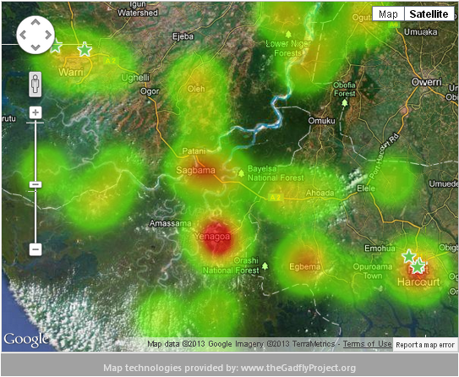
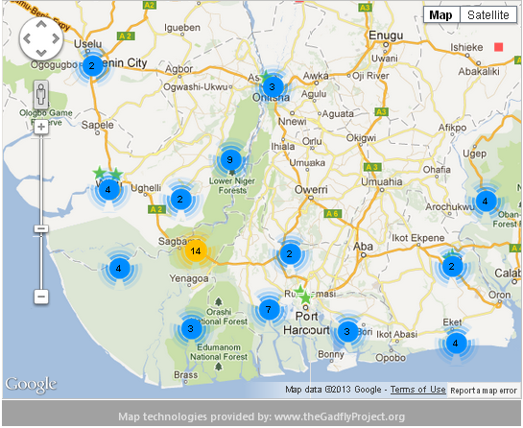
Flooding in 2012: Plan Ahead

Slide 17
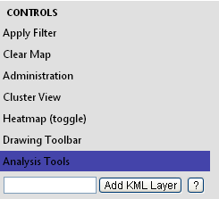
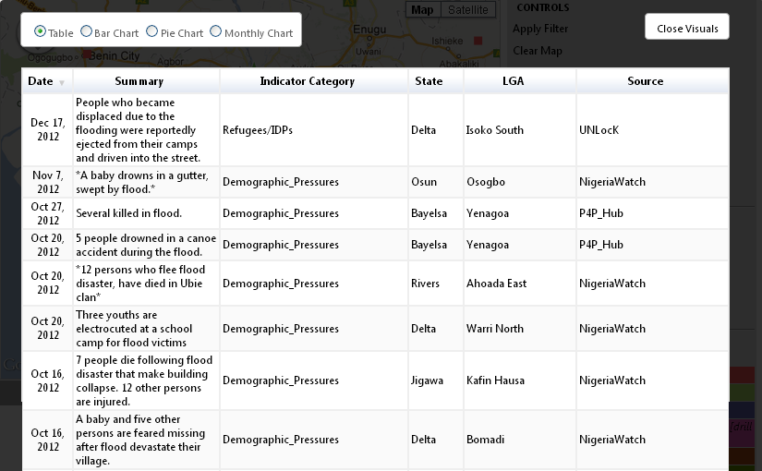
Flooding in 2012: Plan Ahead
Table can be sorted by Date, Category, Geography, or Source

Slide 18
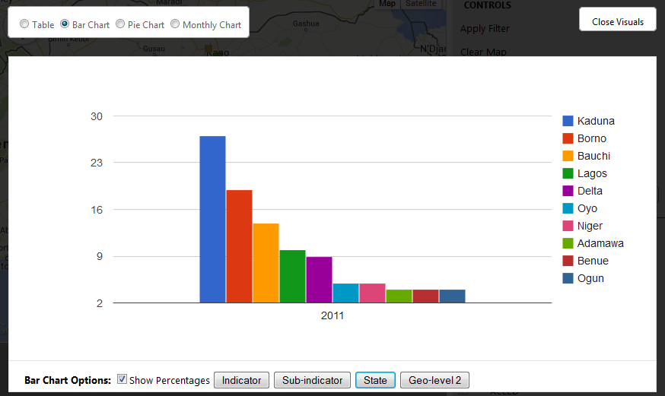
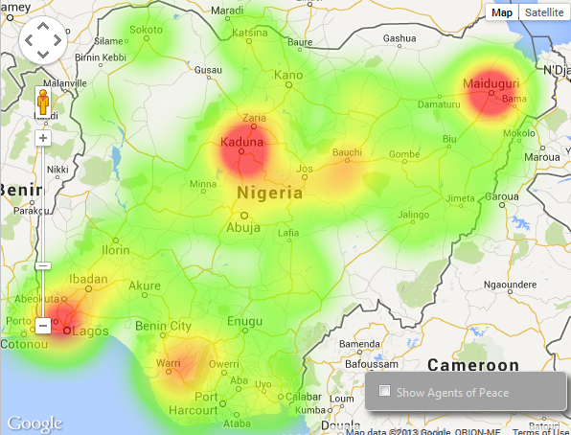
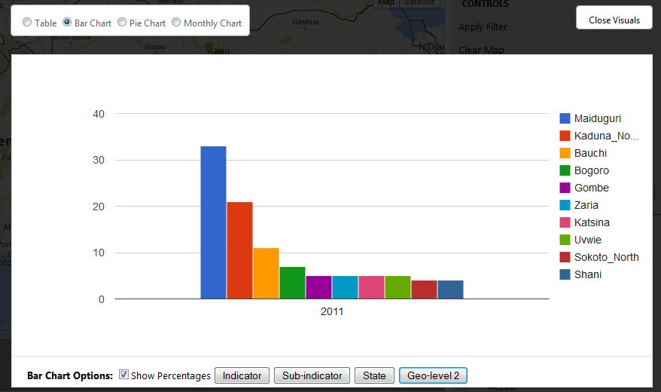
2011 Election Violence by State/LGA %
Plan Ahead for 2015

Slide 19
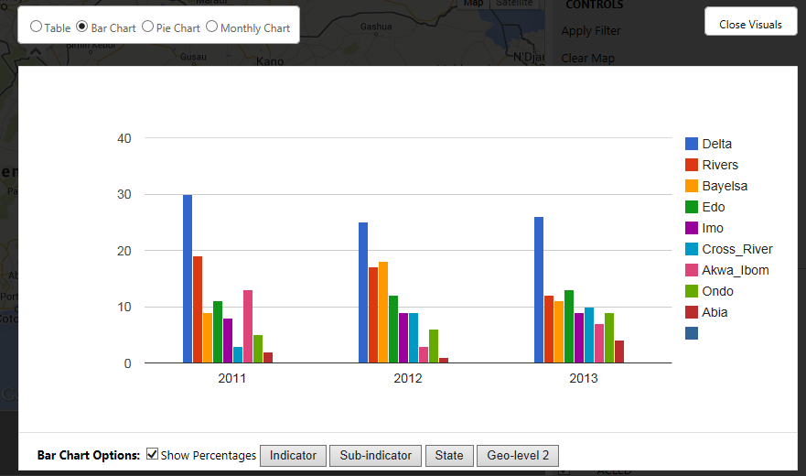
% Violence in Niger Delta by State
User can switch between raw tally and percentage
Queries on the Indicator, Sub-Indicator, State, or LGA levels
Maximum sample: 10

Slide 20
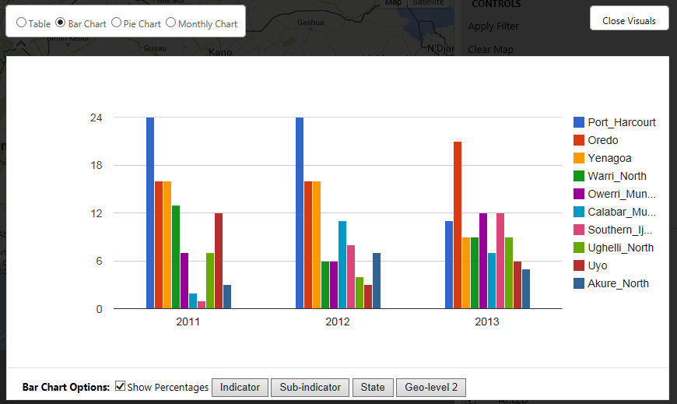
% Violence in Niger Delta by LGA

Slide 21
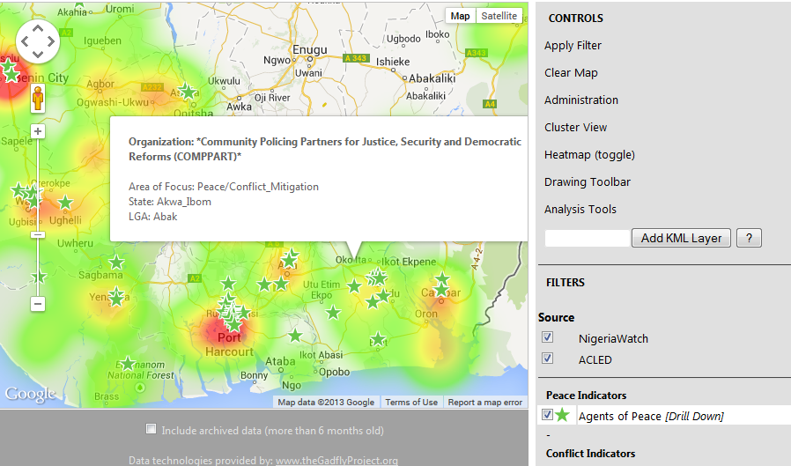
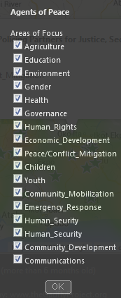
Closing the Loop (Risk/Response)

Slide 22
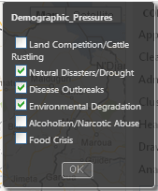
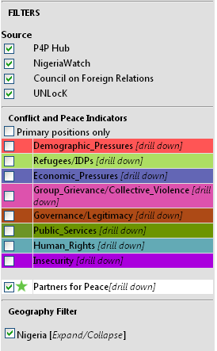
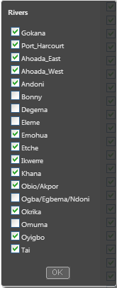

Searchable Data
Query Risk by SOURCE
Query Risk by CATEGORY: (Indicator and Sub-Indicator)
Query Risk by GEOGRAPHY: (State and LGA)
Query Risk by DATE RANGE

Slide 23
Challenges With Multi-Stakeholder Collaboration
Different Mandates and Goals
Use Different Language
Think in Different Time Horizons
Different Cultures of Information Sharing

Slide 24

www.p4p-nigerdelta.org

Slide 25
Path Forward
New Features and Functions
More Stakeholders Mapped
More Data Sets
A WEB MAP IS NOT ENOUGH
  Multi-Stakeholder Information Sharing and Collaboration for Improved Conflict Management

Slide 26
nhaken@fundforpeace.org www.fundforpeace.org www.p4p-nigerdelta.org

